Slide 1
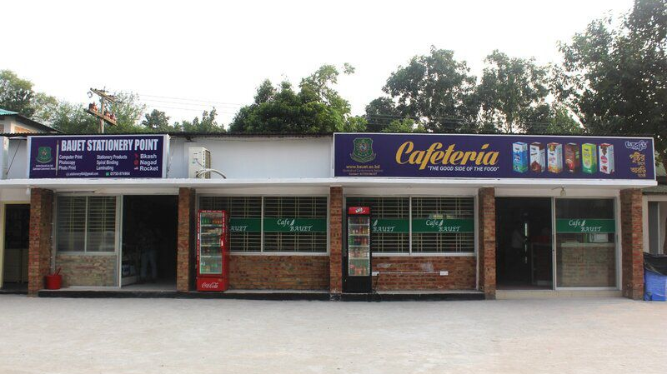
BAUET Cafeteria Management System

Slide 2

Presented By Presented To
Name : Tamanna Habib Md. Nazmus Salehin ID : 0812310105101040 Lecturer Name : Muzthoba Labib Dept. of CSE, BAUET ID : 0812310205101042 Name : Zuhair Ibtehaz Barson Md. Arafat Ibna Mizan ID : 0812310205101064 Lecturer Batch : 17th Dept. of CSE, BAUET Year : 3rd
Semester : 1st Section : B Session : 2022-2023

Slide 3

Outline
Introduction
Existing System
Problem Statement
Objectives
Project Architecture
Database Architecture
Project Description
Attained Objectives
Target Customers
Project Screenshots
Project Video
Future Work
Conclusion
References

Slide 4

Introduction
Web-based solution for efficient food ordering
Designed for students, faculty & cafeteria staff
Built using React.js and Firebase

Slide 5
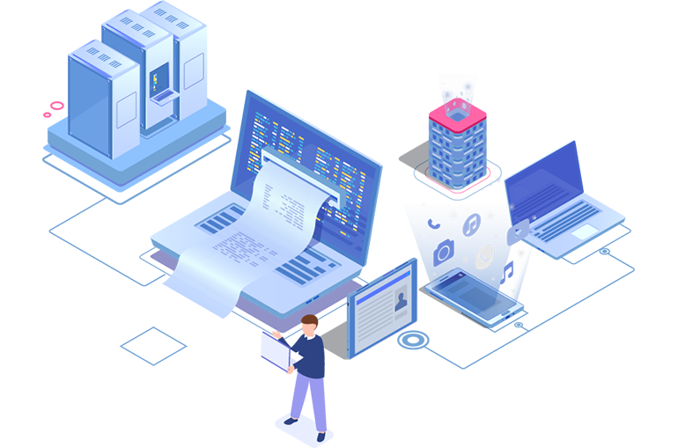
Existing System
Manual order taking and billing
No real-time order tracking
Limited communication between users and staff
Time-consuming for both customers and cafeteria workers
No digital record of sales or menu updates

Slide 6

Problem Statement
Manual ordering causes delays and confusion
No digital system for tracking or managing orders
Errors in billing and inventory handling
Long queues during peak hours
Lack of order transparency for students and staff

Slide 7

Objectives
Automate cafeteria order management
Improve user experience and efficiency
Enable real-time order tracking
Simplify admin operations

Slide 8

Project Architecture
React.js frontend
Firebase backend
Real-time database communication
Responsive interface

Slide 9
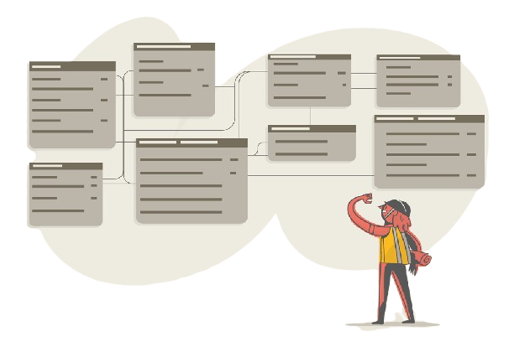
Database Architecture
Firebase Realtime Database
Collections: Users, Categories, Orders, Items
Role-based access (User/Admin)
Data synchronized in real-time

Slide 10

Project Description
User module: Registration, browsing, cart, orders
Admin module: Manage menu, categories, orders
Real-time order updates
Responsive design

Slide 11
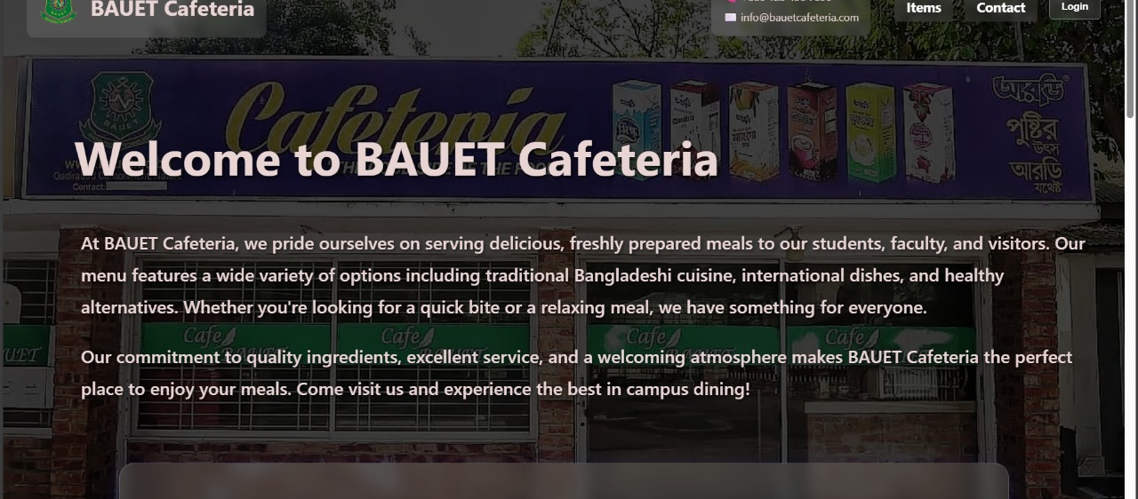
Home Page

Slide 12
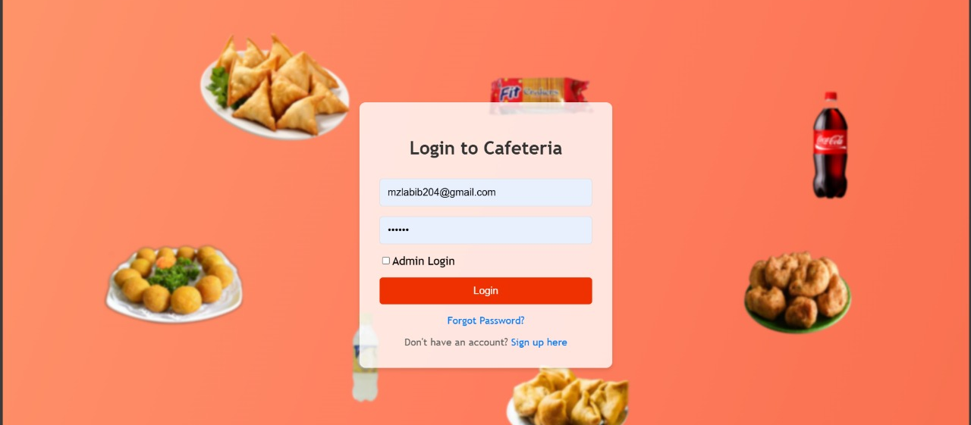
Login Page

Slide 13
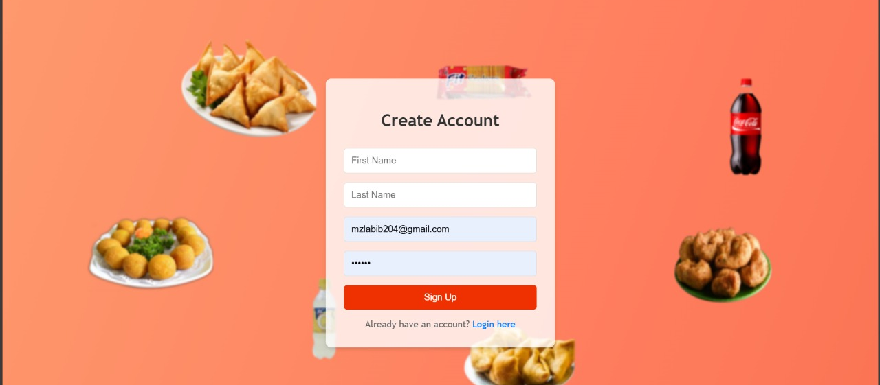
Sign Up Page

Slide 14
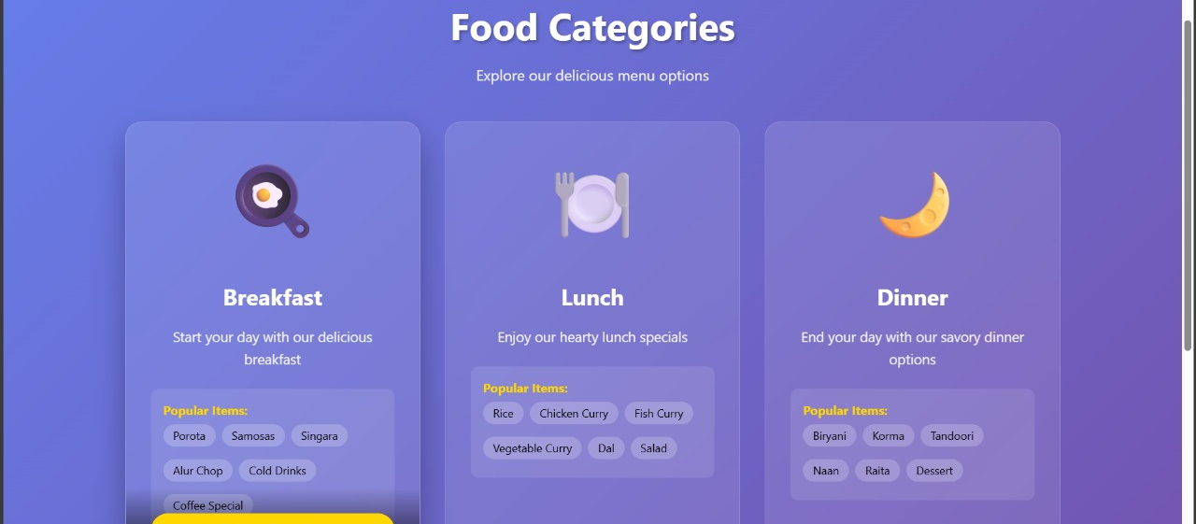
Food Category Page (User)

Slide 15
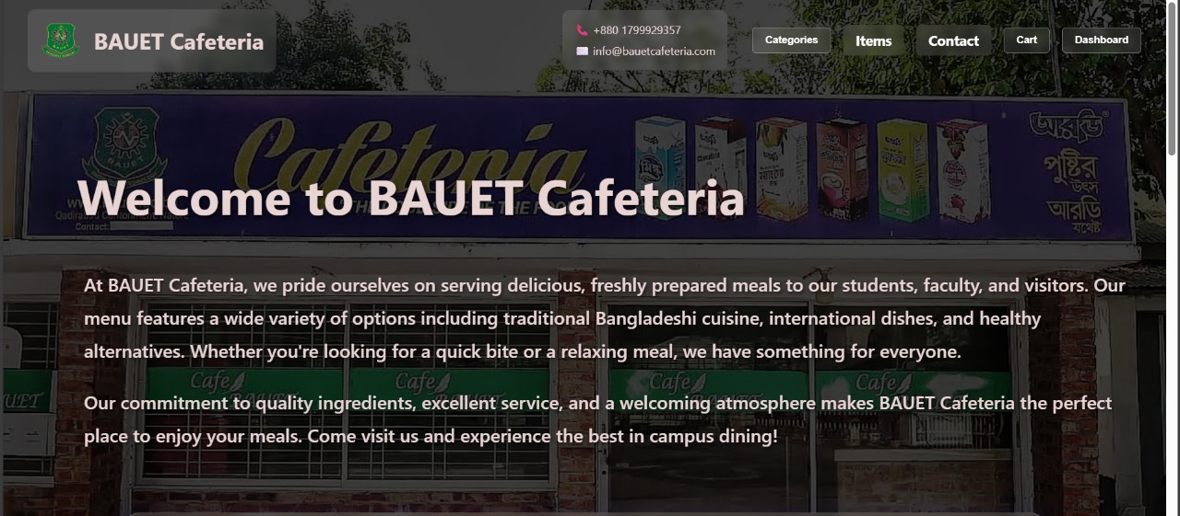
Login Page (User)

Slide 16
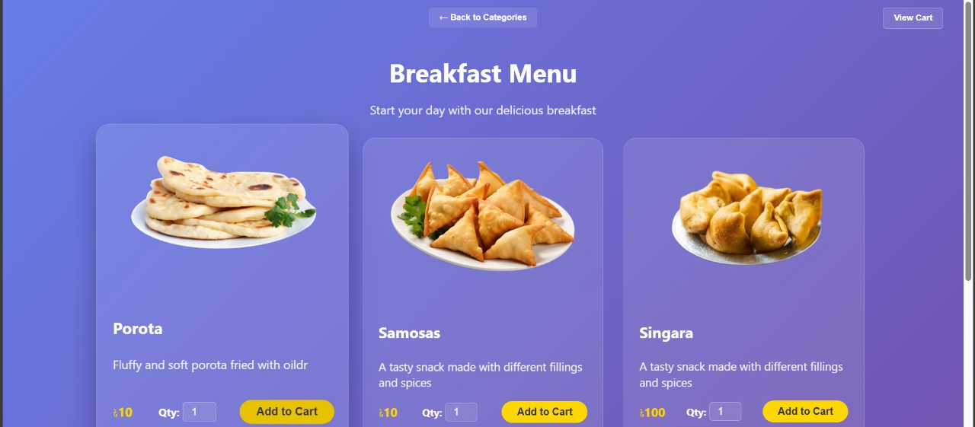
Food Items Page

Slide 17
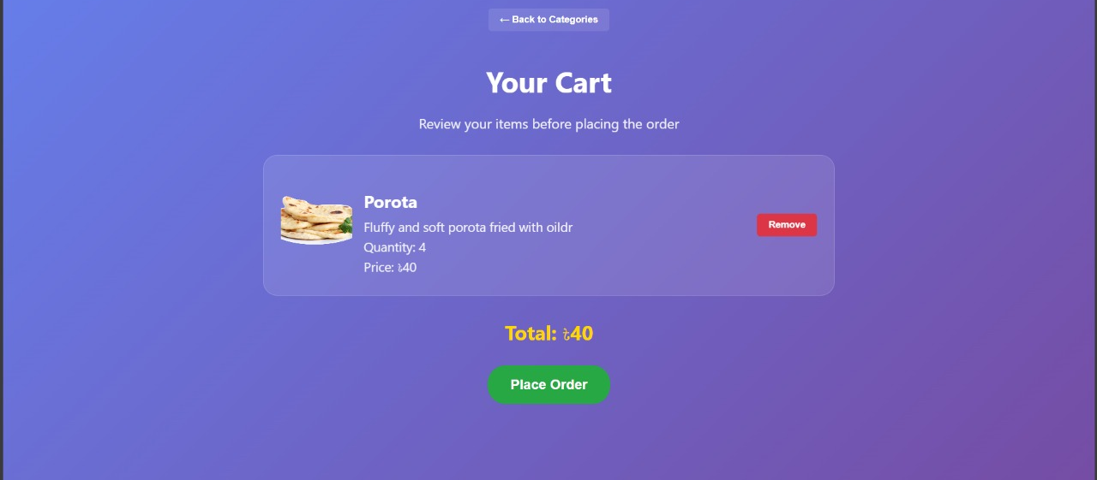
Cart Page

Slide 18
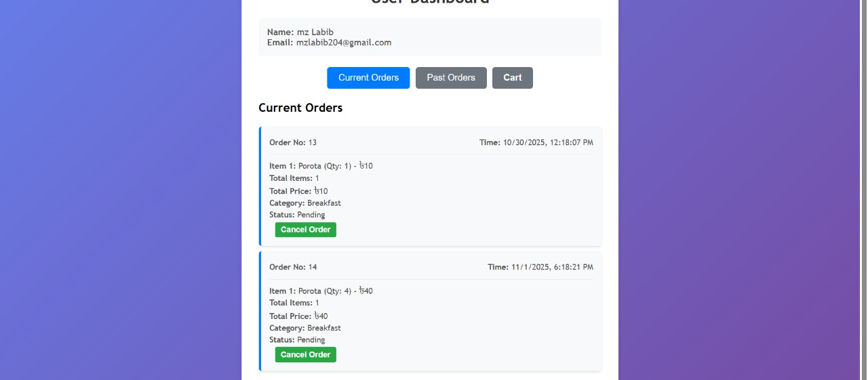
Dashboard (User)

Slide 19
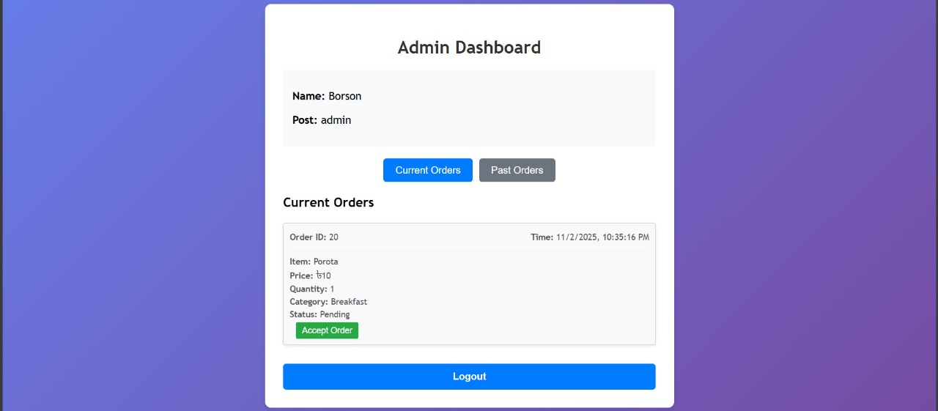
Dashboard (Admin)

Slide 20
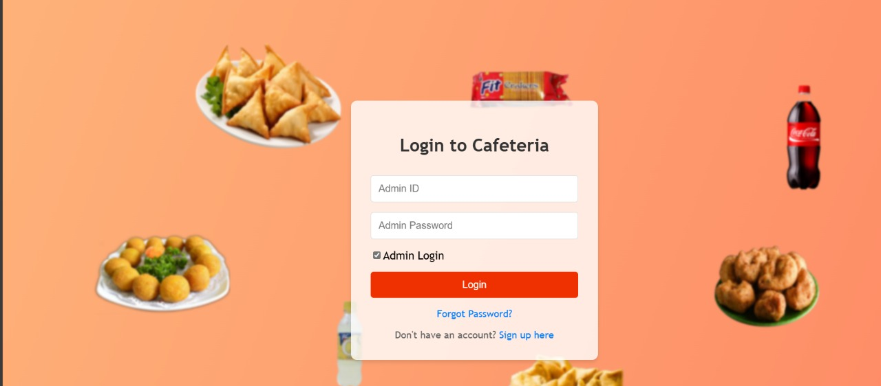
Login (Admin)

Slide 21
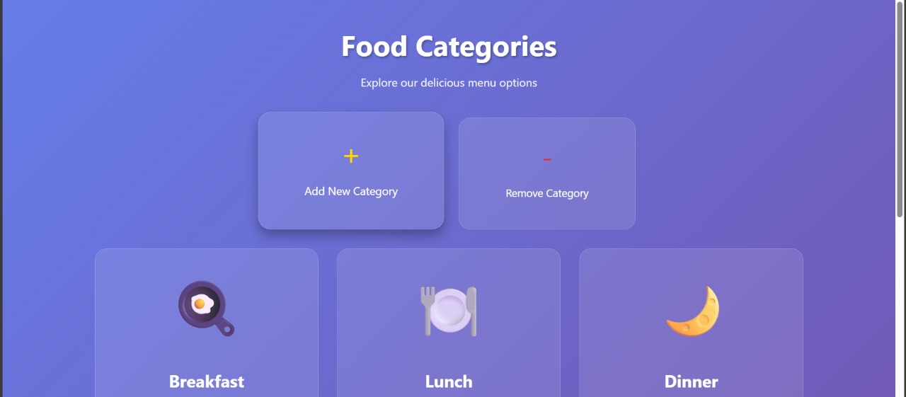
Category Managing Page (Admin)

Slide 22
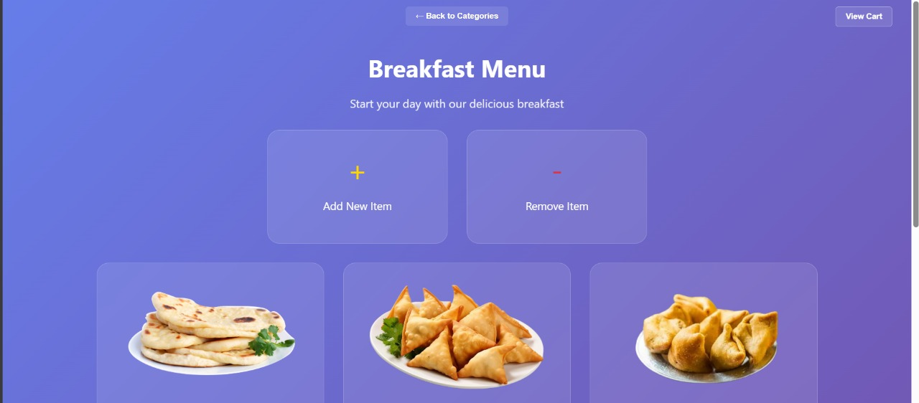
Item Managing Page (Admin)

Slide 23
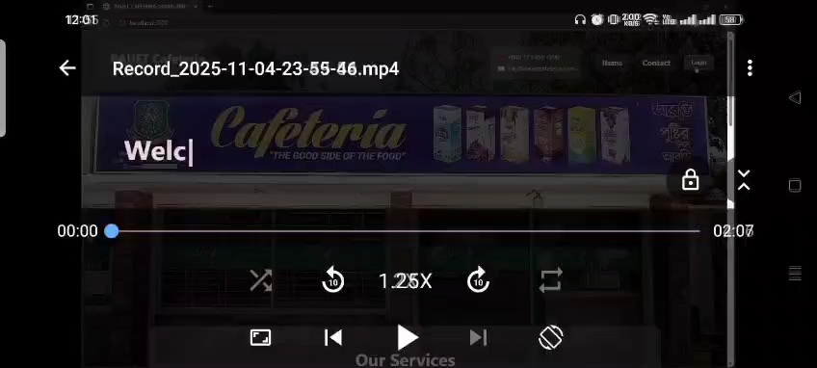

Slide 24

Attained Objectives
Fully functional order system
Firebase integration complete
Role-based authentication
Real-time synchronization achieved

Slide 25

Future Works
Payment Integration
Push Notifications
Advanced Analytics
Inventory Tracking
User Reviews and Ratings
Mobile App Version
Multi-Language Support

Slide 26

Conclusion
Simplifies cafeteria management
Real-time & responsive system
Scalable and user-friendly
Demonstrates modern web development

Slide 27



Thank You
Tamanna Habib
Muzthoba Labib
Zuhair Ibtehaz Barson

